Slide 1
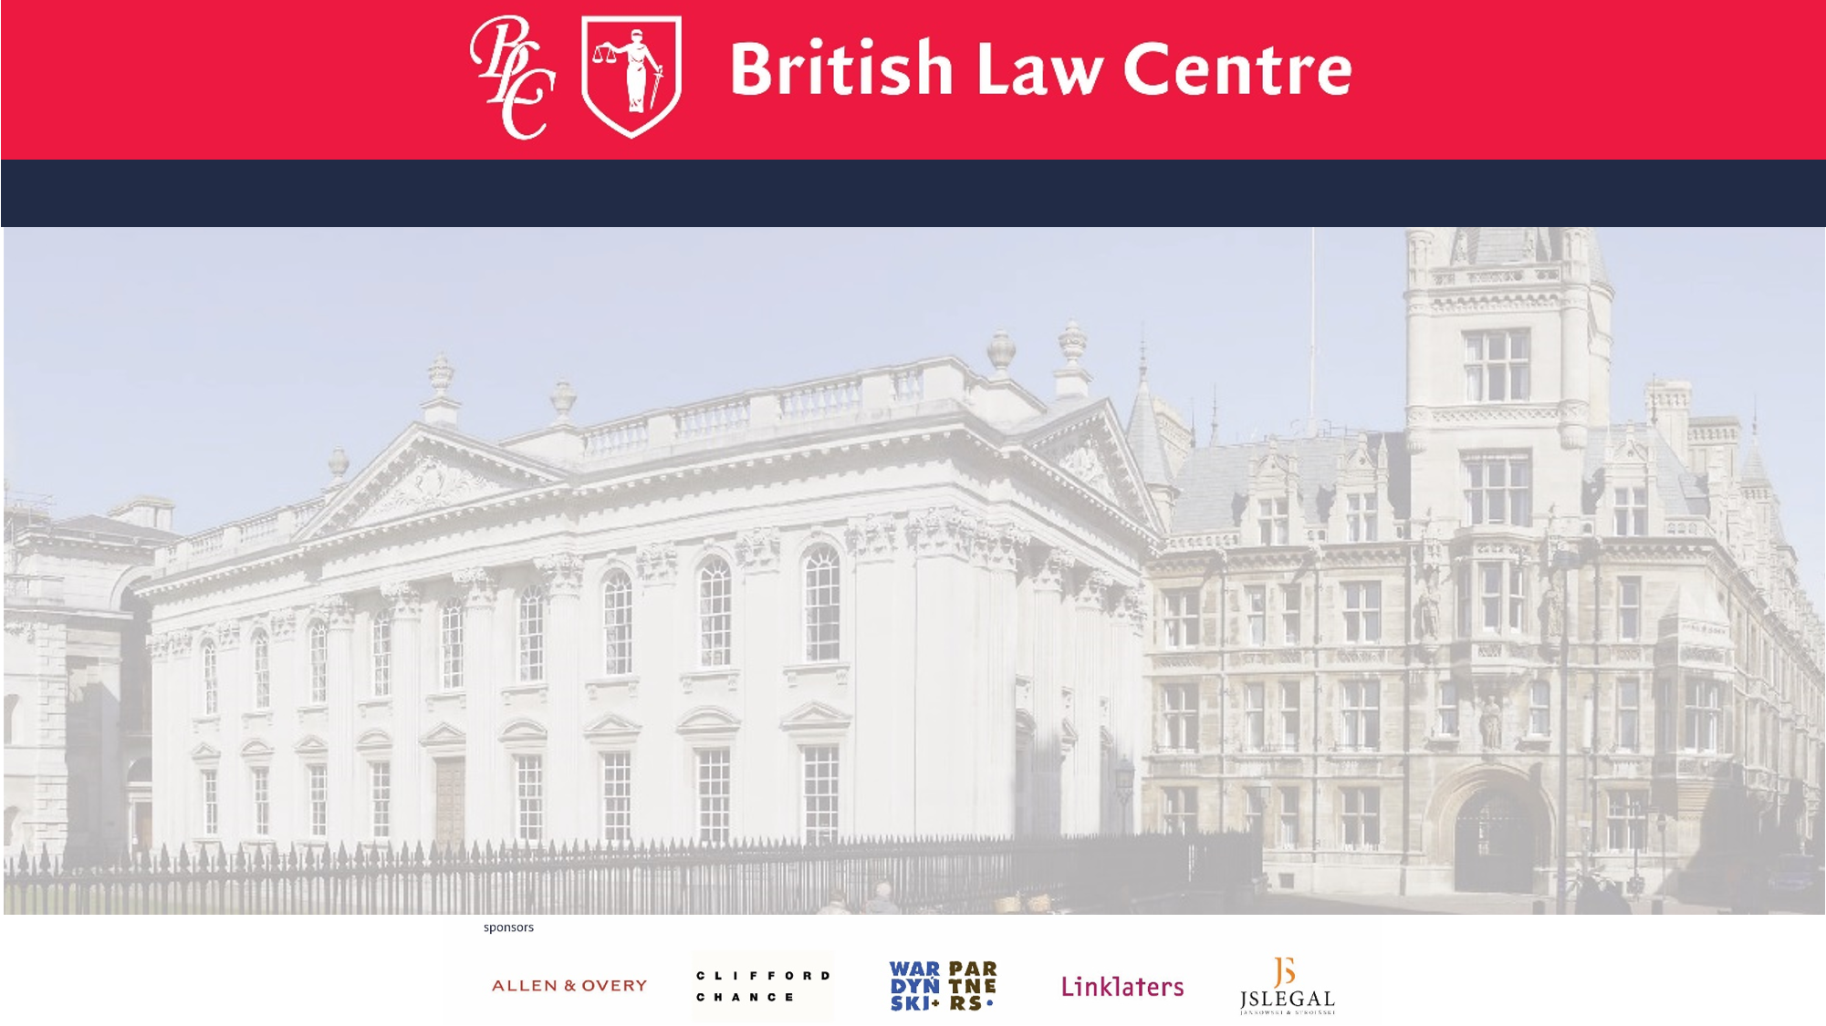
Are you fluent in English
but want to improve
your English legal language?
Do you want to find out more about the common law and how common lawyers think?
And how judges create law?
Interested in EU law and want to see the common law perspective?
Then come and study at the British Law Centre at
JU Faculty of Law and Administration

Slide 2
The Graduate Diploma in English and European Union law is open to all lawyers, linguists and graduate who have an interest in learning more of the common law system and English and European Union law
And
who wish to learn more of the legal skills central to the training of the English common lawyer.
Come and study at the British Law Centre at
JU Faculty of Law and Administration

Slide 3
For more information
http://www.english.law.uj.edu.pl
CENTER FOR THE COORDINATION OF FOREIGN LAW SCHOOLS 12 Bracka STREET 31-005 Kraków Tel: (+48) 124220908 mail: english.law@uj.edu.pl
Then come and study at the British Law Centre at
JU Faculty of Law and Adminstration
apply to britishlawcentre.co.uk

Slide 4
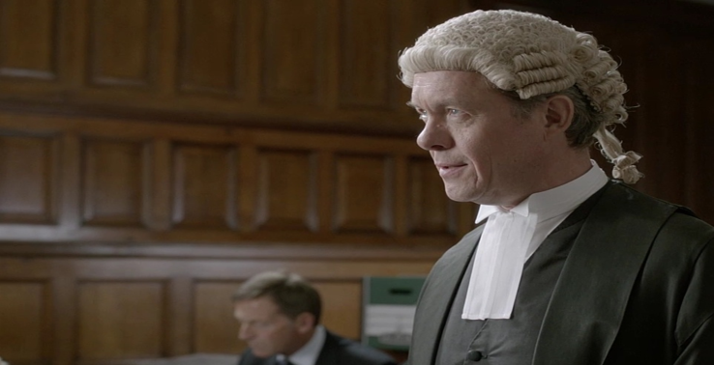
Come and find out more about us
GUEST LECTURE
Denise Ashmore
BLC Course Director
Friday 2nd October 2015
At 17.00
In room 203, 12 Bracka street
The Common Law Methodology? Where judges are a source of law
Enrol for the British Law Centre
Diploma in 2015-16
britishlawcentre.co.uk

